Slide 1
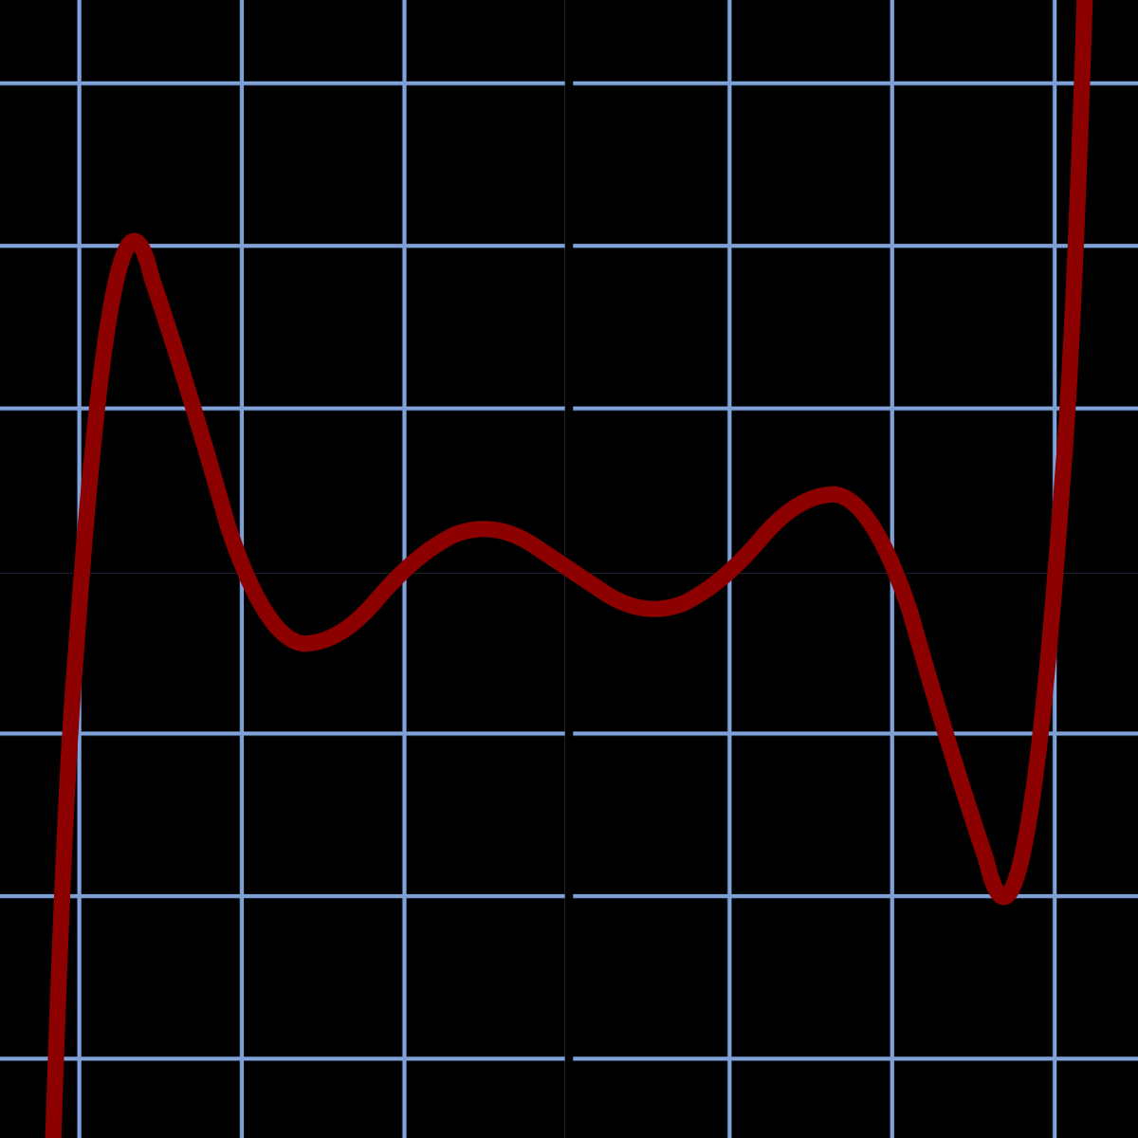
Nonlinear differential algorithm to compute all the zeros of a generic polynomial
Titas Geryba

Slide 2
The Background
Polynomial
Def. A polynomial is a mathematical expression involving a sum of powers in one or more variables multiplied by coefficients.
We can factor a polynomial and rewrite it in the form:

Slide 3

The Background
Polynomial
Def. A polynomial is a mathematical expression involving a sum of powers in one or more variables multiplied by coefficients.
We can factor a polynomial and rewrite it in the form:

Slide 4
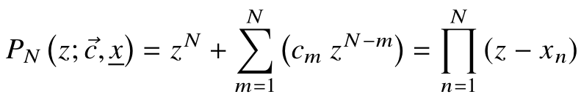
The Algorithm
We will consider monic polynomials (leading coefficient = 1) as follows:

Slide 5

The Algorithm
We will consider monic polynomials as follows:
We then introduce that coefficients and zeros can change over a variable $t$ :

Slide 6
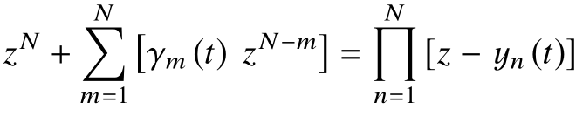
The Algorithm

Slide 7
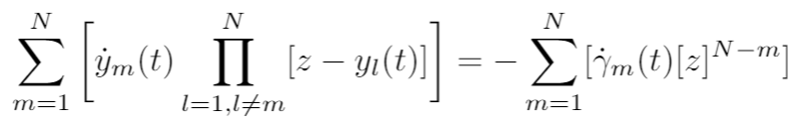
The Algorithm

Slide 8

The Algorithm
$$Let z=y_{n}(t)$$

Slide 9
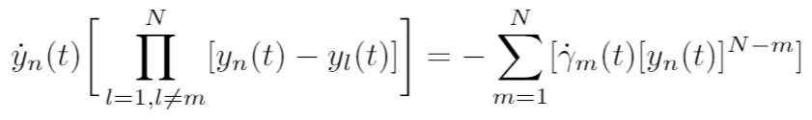
The Algorithm
$$Let z=y_{n}(t)$$

Slide 10
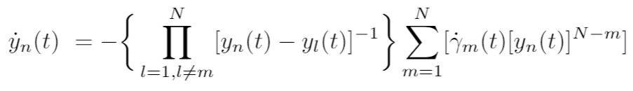
The Algorithm
$$Let z=y_{n}(t)$$

Slide 11
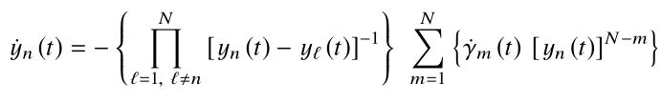
The Algorithm

Slide 12

The Algorithm

Slide 13


The Algorithm

Slide 14

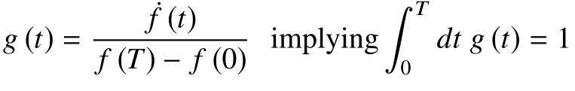
The Algorithm

Slide 15
The Algorithm

Slide 16
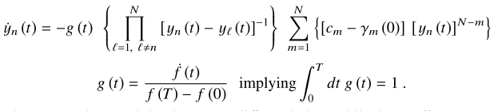
The Algorithm
Abel–Ruffini theorem

Slide 17

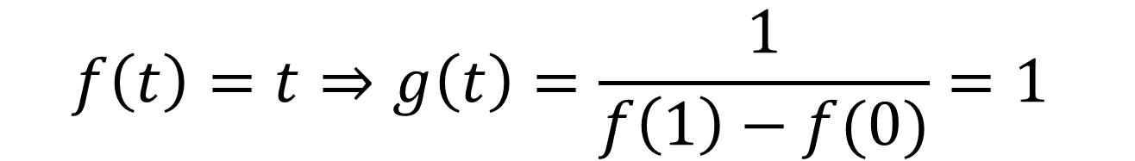
The Algorithm
$$T=1$$
$$f\left(t\right)=t⇒g\left(t\right)=\frac{1}{f\left(1\right)−f(0)}=1$$

Slide 18

The Algorithm
$$T=1$$
$$f\left(t\right)=t⇒g\left(t\right)=\frac{1}{f\left(1\right)−f(0)}=1$$
$$\int_{0}^{T}{dt g\left(t\right)=\int_{0}^{1}{dt 1=1}}$$

Slide 19

The Algorithm
$$g\left(t\right)=1, T=1$$

Slide 20
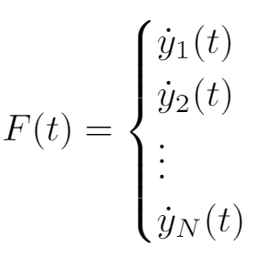
The Algorithm
$$g\left(t\right)=1, T=1$$

Slide 21


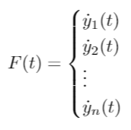

The Algorithm
Generate the initial guesses for the polynomial’s zeros at t = 0
Calculate the time dependent coefficients’ values
Integrate the system of equations numerically
$$g\left(t\right)=1, T=1$$

Slide 22
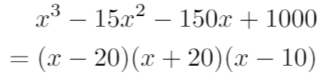
Example 1

Slide 23

Example 1
$$−100≤{Re(y}_{i}\left(0\right))≤100$$
$$−100≤{Im(y}_{i}\left(0\right))≤100$$

Slide 24
Example 1
$$−100≤{Re(y}_{i}\left(0\right))≤100$$
$$−100≤{Im(y}_{i}\left(0\right))≤100$$
Initial Value | After Iteration
71.1406749978-16.2823174277i
-84.7349639578+55.126702689i
95.5650319505-73.1030055883i

Slide 25
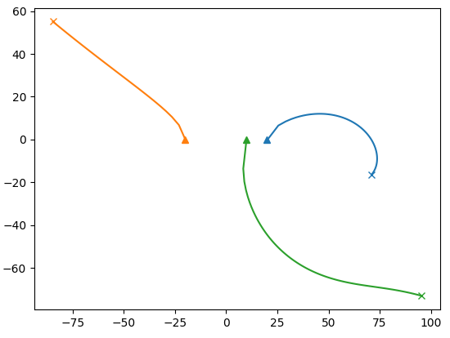

Iteration 1
Example 1
Abel–Ruffini theorem
$$−100≤{Re(y}_{i}\left(0\right))≤100$$
$$−100≤{Im(y}_{i}\left(0\right))≤100$$
$$time step h=0.01$$
Initial Value | After Iteration
71.1406749978-16.2823174277i | 20.0370960114-0.266170648667i
-84.7349639578+55.126702689i | -19.9976154713+0.0311076576057i
95.5650319505-73.1030055883i | 9.9605194599+0.235062991061i

Slide 26
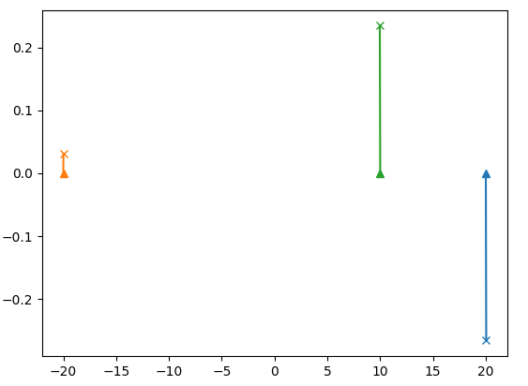
Iteration 2
Example 1
$$−100≤{Re(y}_{i}\left(0\right))≤100$$
$$−100≤{Im(y}_{i}\left(0\right))≤100$$
$$time step h=0.01$$
Initial Value | After Iteration
20.0370960114-0.266170648667i | 20+1.75207071074e-16i
-19.9976154713+0.0311076576057i | -20-2.21719344273e-17i
9.9605194599+0.235062991061i | 10+1.95156391047e-17i

Slide 27
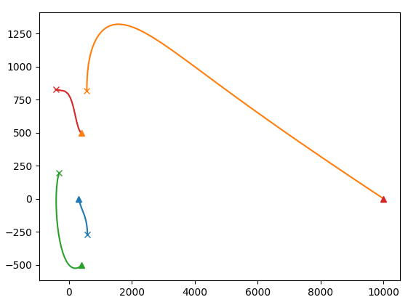
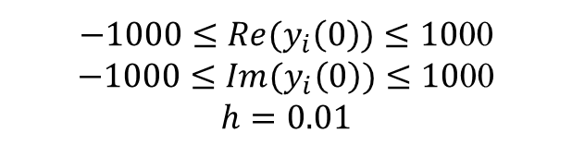
Example 2
Iteration 1
Initial Value | After Iteration
585.655713746-269.955507343i | 300.001015787+0.000710725589028i
564.148717961+816.963408841j | 9998.99930425+0.000165669875692i
-314.12545548+197.401514585i | 400.000338707-500.000649204i
-426.088792188+825.795241733i | 399.999341253+499.999772808i
$−1000≤{Re(y}_{i}\left(0\right))≤10$00
$−1000≤{Im(y}_{i}\left(0\right))≤10$00
$$h=0.01$$

Slide 28
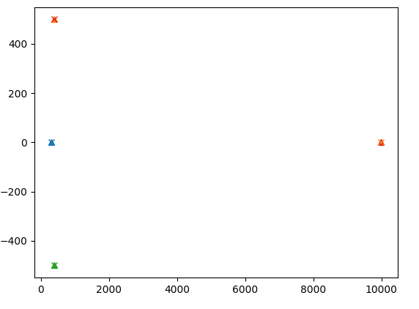
Example 2
Iteration 2
Initial Value | After Iteration
300.001015787+0.000710725589028i | 300.00000000000011-8.6230971161845894e-14j
9998.99930425+0.000165669875692i | 9998.9999999999854+7.464394626691454e-15i
400.000338707-500.000649204i | 400-499.99999999999983i
399.999341253+499.999772808i | 400+499.99999999999994i
$−1000≤{Re(y}_{i}\left(0\right))≤10$00
$−1000≤{Im(y}_{i}\left(0\right))≤10$00
$$h=0.01$$

Slide 30
Generate N random zeros
Expand the zeros to create a polynomial
Solve for zeros numerically
Compare the original zeros with the approximated zeros

Slide 31
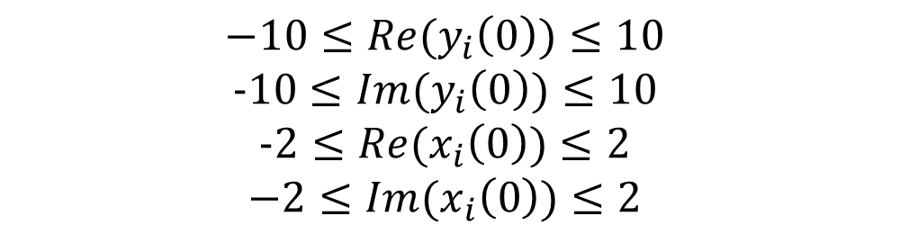
Generate N random zeros
Expand the zeros to create a polynomial
Solve for zeros numerically
Compare the original zeros with the approximated zeros
$$−10≤{Re(y}_{i}\left(0\right))≤10$$
$$-10≤{Im(y}_{i}\left(0\right))≤10$$
$$-2≤{Re(x}_{i}\left(0\right))≤2$$
$$−2≤{Im(x}_{i}\left(0\right))≤2$$

Slide 32
Factors I considered
1.
Time step
Number of iterations

Slide 33
Time Step
1.

Slide 34
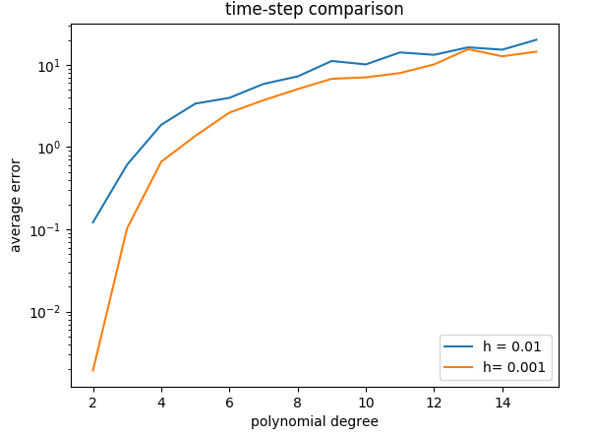
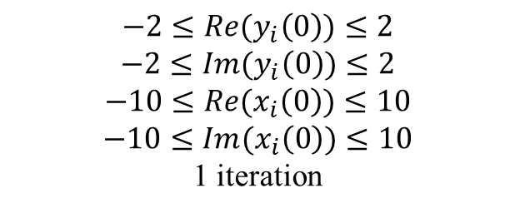
Time step
$$−2≤{Re(y}_{i}\left(0\right))≤2$$
$$−2≤{Im(y}_{i}\left(0\right))≤2$$
$$−10≤{Re(x}_{i}\left(0\right))≤10$$
$$−10≤{Im(x}_{i}\left(0\right))≤10$$
1 iteration

Slide 35
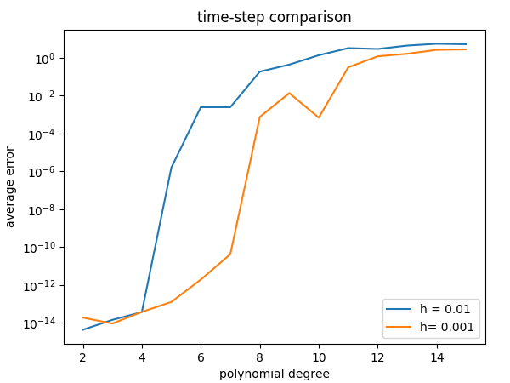
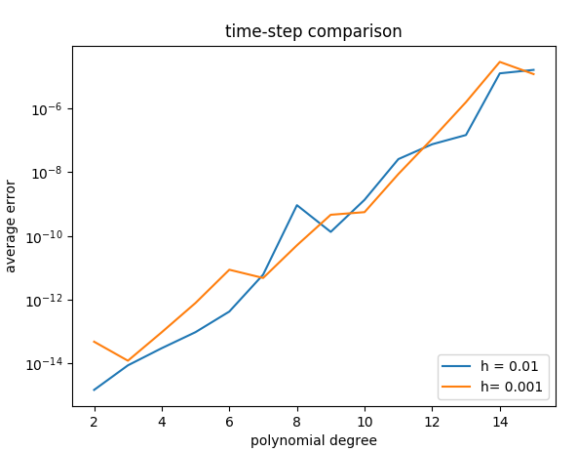
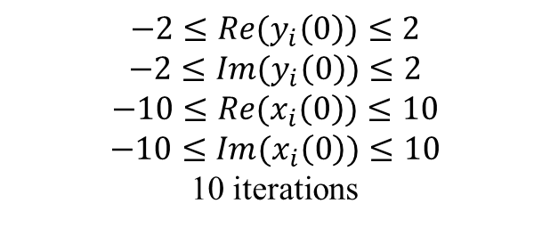
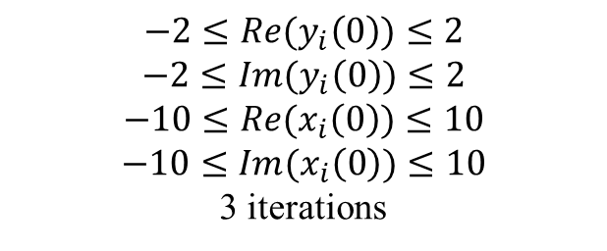
Time step
$$−2≤{Re(y}_{i}\left(0\right))≤2$$
$$−2≤{Im(y}_{i}\left(0\right))≤2$$
$$−10≤{Re(x}_{i}\left(0\right))≤10$$
$$−10≤{Im(x}_{i}\left(0\right))≤10$$
3 iterations
$$−2≤{Re(y}_{i}\left(0\right))≤2$$
$$−2≤{Im(y}_{i}\left(0\right))≤2$$
$$−10≤{Re(x}_{i}\left(0\right))≤10$$
$$−10≤{Im(x}_{i}\left(0\right))≤10$$
10 iterations

Slide 36
Iteration Number
1.

Slide 37
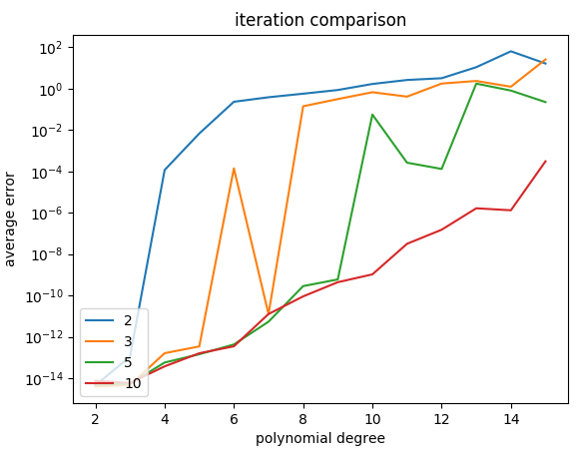

Iteration Number
$$−2≤{Re(y}_{i}\left(0\right))≤2$$
$$−2≤{Im(y}_{i}\left(0\right))≤2$$
$$−10≤{Re(x}_{i}\left(0\right))≤10$$
$$−10≤{Im(x}_{i}\left(0\right))≤10$$
$$h=0.01$$

Slide 38
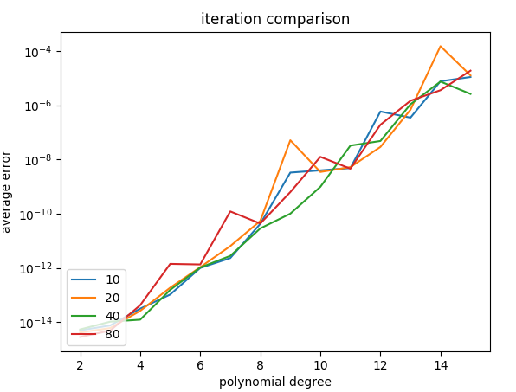
Iteration Number
$$−2≤{Re(y}_{i}\left(0\right))≤2$$
$$−2≤{Im(y}_{i}\left(0\right))≤2$$
$$−10≤{Re(x}_{i}\left(0\right))≤10$$
$$−10≤{Im(x}_{i}\left(0\right))≤10$$
$$h=0.01$$

Slide 39


Combined
$$−2≤{Re(y}_{i}\left(0\right))≤2$$
$$−2≤{Im(y}_{i}\left(0\right))≤2$$
$$−10≤{Re(x}_{i}\left(0\right))≤10$$
$$−10≤{Im(x}_{i}\left(0\right))≤10$$
$$h=0.01$$
$$−2≤{Re(y}_{i}\left(0\right))≤2$$
$$−2≤{Im(y}_{i}\left(0\right))≤2$$
$$−10≤{Re(x}_{i}\left(0\right))≤10$$
$$−10≤{Im(x}_{i}\left(0\right))≤10$$
$$iterations=10$$

Slide 40
What about polynomials with bigger coefficients?
higher degree?

Slide 41
What about polynomials with bigger coefficients?
Generate N random coefficients and make a polynomial from them.
Find the zeros of this polynomial using the algorithm.
Expand the zeros to generate approximate coefficients.
Compare original coefficients with approximated coefficients.

Slide 42
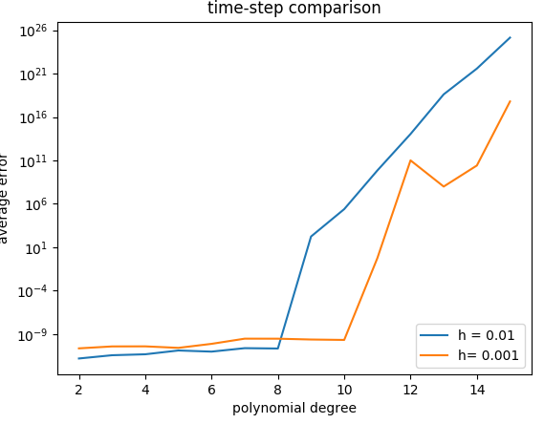

$$−10000≤{Re(y}_{i}\left(0\right))≤10000$$
$$−10000≤{Im(y}_{i}\left(0\right))≤10000$$
$−10000≤Re(c_{m})≤10$000
$$−10000≤Im(c_{m})≤10000$$
$$iterations=10$$

Slide 43
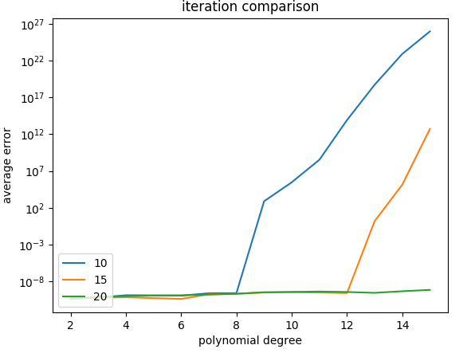

$$−10000≤{Re(y}_{i}\left(0\right))≤10000$$
$$−10000≤{Im(y}_{i}\left(0\right))≤10000$$
$−10000≤Re(c_{m})≤10$000
$$−10000≤Im(c_{m})≤10000$$
$$h=0.01$$

Slide 44
Thank you for listening

Slide 45
Extra slides in case needed during questions. Not part of presentation.

Slide 46
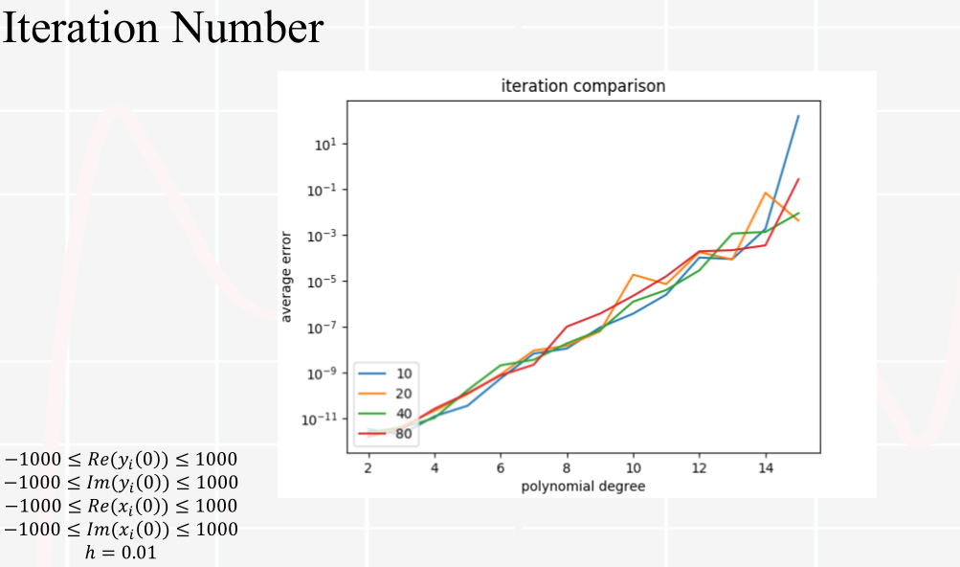

Slide 47
Original Coefficients
26.64217938+52.97154236i
5.47138843+65.89068862i
2.28886421+28.28523669i
69.78152008+93.94533544i
75.10168980+42.09074322i
38.94603962 +6.62592201i
97.17776530+27.83221136i
Coefficient error
2.08370334311e-12
10 iterations
Evaluation error
0.00311678812213

Slide 48
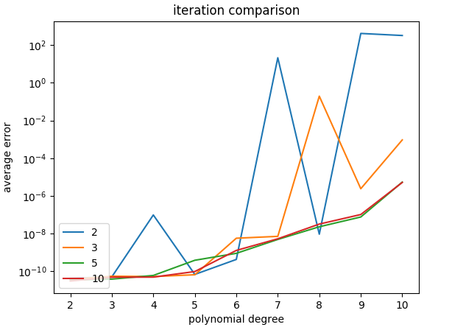
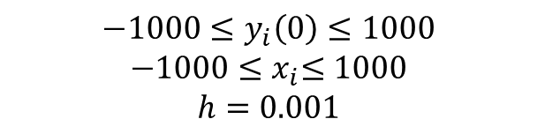
$$−1000≤y_{i}\left(0\right)≤1000$$
$${−1000≤x}_{i}≤1000$$
$$h=0.001$$

Slide 49
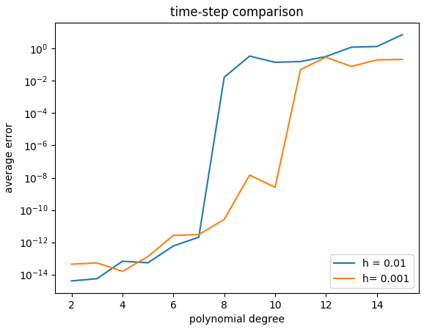
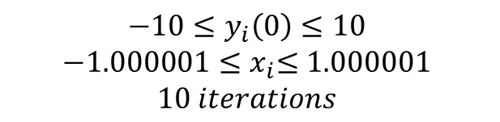
$$−10≤y_{i}\left(0\right)≤10$$
$${−1.000001≤x}_{i}≤1.000001$$
$$10 iterations$$

Slide 50
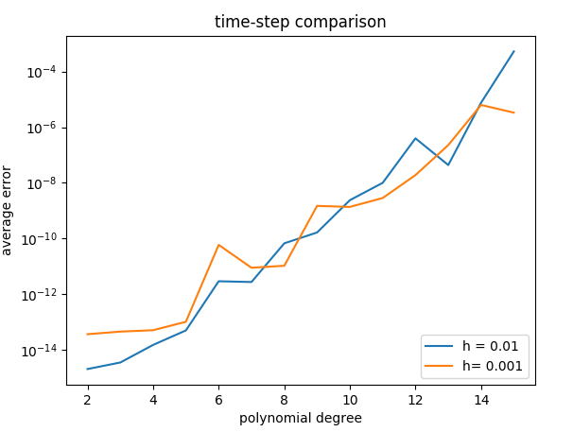

$$−10≤y_{i}\left(0\right)≤10$$
$${−1.000000001≤x}_{i}≤1.000000001$$
$$10 iterations$$

Slide 51
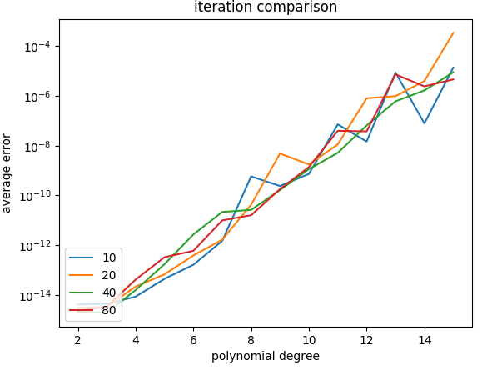
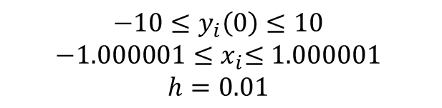
$$−10≤y_{i}\left(0\right)≤10$$
$${−1.000001≤x}_{i}≤1.000001$$
$$h=0.01$$

Slide 52
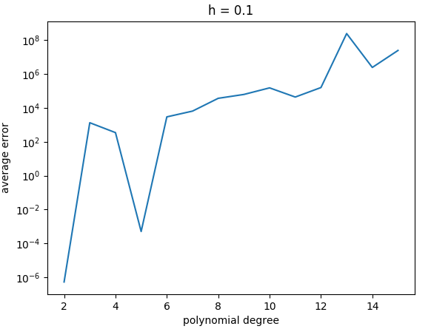
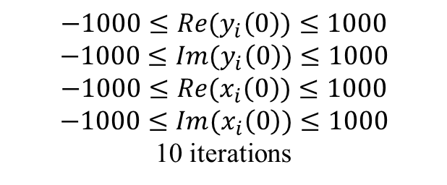
Time step
$$−1000≤{Re(y}_{i}\left(0\right))≤1000$$
$$−1000≤{Im(y}_{i}\left(0\right))≤1000$$
$$−1000≤{Re(x}_{i}\left(0\right))≤1000$$
$$−1000≤{Im(x}_{i}\left(0\right))≤1000$$
10 iterations

Slide 53
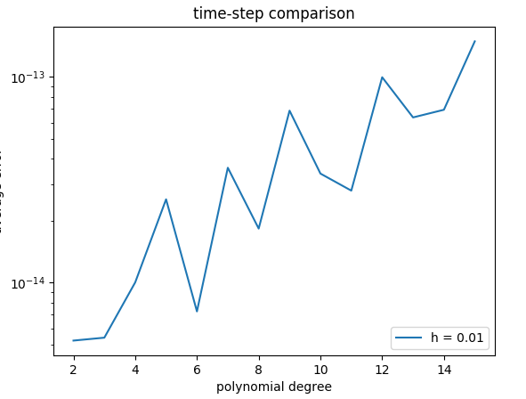

How about evaluating the zero?
$$−10≤{Re(y}_{i}\left(0\right))≤10$$
$$−10≤{Im(y}_{i}\left(0\right))≤10$$
$$−2≤{Re(c}_{n})≤2$$
$$−2≤{Im(c}_{n})≤2$$
$$iterations=10$$

Slide 54
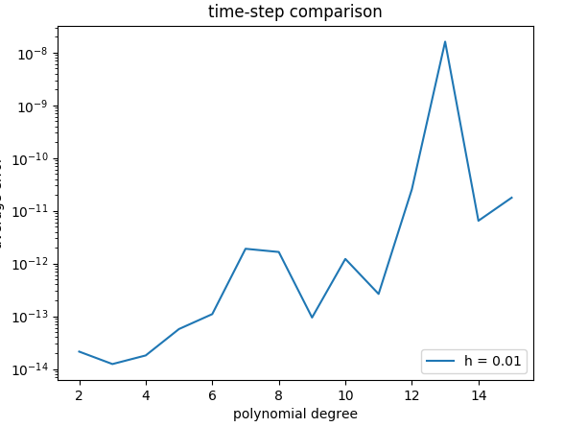

How about evaluating the zero?
$$−10≤{Re(y}_{i}\left(0\right))≤10$$
$$−10≤{Im(y}_{i}\left(0\right))≤10$$
$$−5≤{Re(c}_{n})≤5$$
$$−5≤{Im(c}_{n})≤5$$
$$iterations=10$$

Slide 55


How about evaluating the zero?
$$−100≤{Re(y}_{i}\left(0\right))≤100$$
$$−100≤{Im(y}_{i}\left(0\right))≤100$$
$$−100≤{Re(c}_{n})≤100$$
$$−100≤Im(c_{n})≤100$$
$$iterations=10$$

